Slide 1




Galactic Gravity Challenge

Slide 2

01
Our Idea
Our idea is about Solar System and the gravity of the planets.

Slide 3
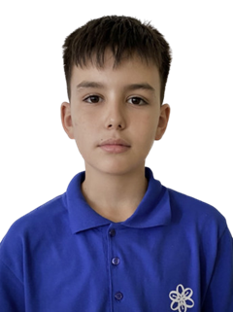
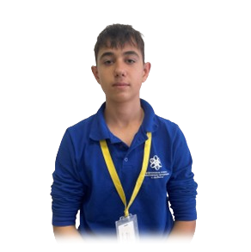
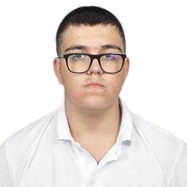
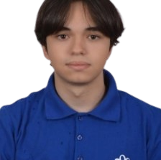

Our Team
02
Scrum Trainer:
Stefan Ivanov
Back-end:
Viktor Kanev
Back-end:
Mihail Nikolov
Back-end:
Veselin Boyanov

Slide 4







Tech used
03

Slide 5
Let’s continue to the game

